Slide 1
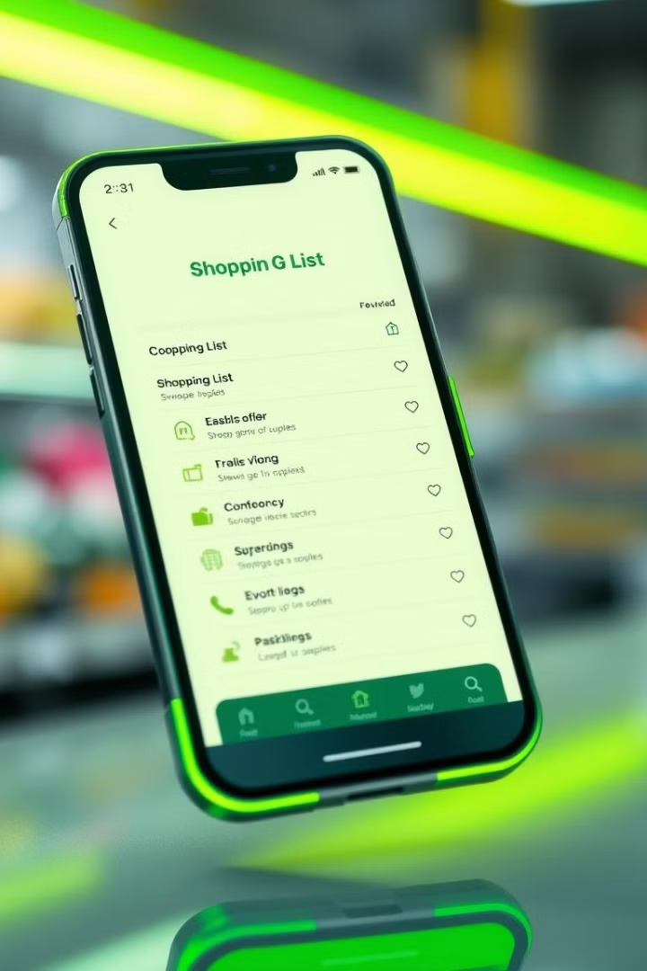
Shopping List App: Built with Modern Web Technologies
This presentation introduces a cross-platform mobile app for efficient grocery management, developed using modern web technologies. It offers a streamlined shopping experience with intuitive features.

Slide 2

Core Functionality: Simplifying Your Shopping
Add Items
Modify Items
Delete Items
Check Complete
Quickly input items with name, quantity, and details. For example: "Milk, 1 gallon, Organic, $10".
Easily update existing items. Change "Milk, 1 gallon, $10" to "Milk, 2 gallons, $20".
Remove unwanted items from the list with a simple swipe or tap.
Mark items as purchased to track progress. Visual confirmation: strikethrough or color change.

Slide 3








Technology Stack
Technologies used in the Shopping List App:
HTML
CSS
JavaScript
React
Structure
Styling
Logic
Frontend Framework
SQLite
Capacitor
Tesseract
MS Project
Local Database
Native Bridge
OCR Module
Project Management Tool

Slide 4

Technology Stack: HTML, CSS, JavaScript, React
HTML (Structure)
Creates the foundation and layout of the user interface.
CSS (Styling)
Enhances the visual appeal with custom styles, fonts, and responsive design. Utilizes CSS frameworks.
JavaScript (Logic)
Implements interactive features and manages app behavior.
React (Framework)
Component-based architecture for efficient UI development.

Slide 5

Capacitor: Bridging Web to Native Android
1
Access device functionalities.
2
Achieve fast, efficient processing.
3
Publish directly to the Google Play Store.
Capacitor is an open-source bridge that enables web applications to run natively on Android devices. This allows access to native device features and functionalities, providing a seamless user experience. See the .apk file of the app running on an android device.

Slide 6
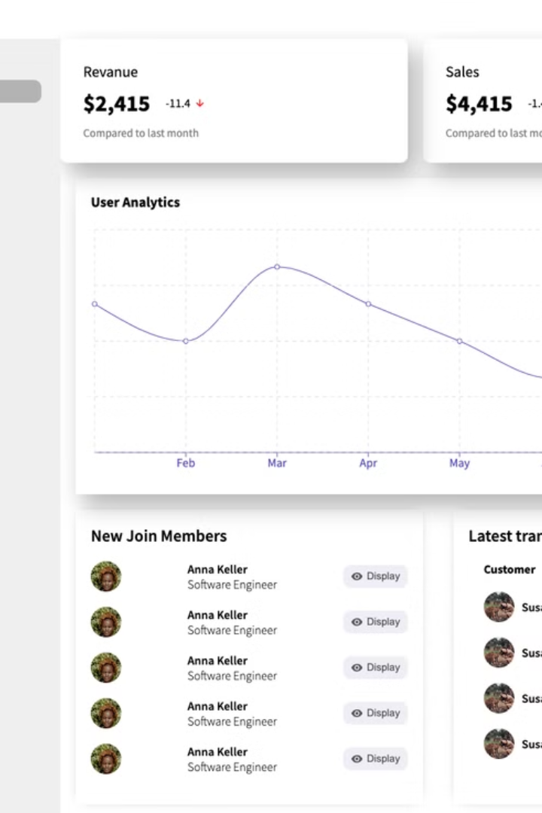



Dashboard & SQLite: Data Storage and Visualization
Lightweight, embedded database for local storage.
Overview of shopping habits and spending trends.
Offline, fast retrieval, and secure storage.

Slide 7
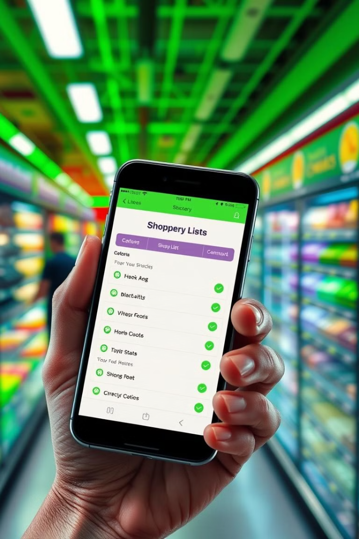
Benefits and Advantages
Single codebase for both iOS and Android.
Access and modify lists without internet.
Intuitive design for seamless navigation.
Leverage web development skills.

Slide 8
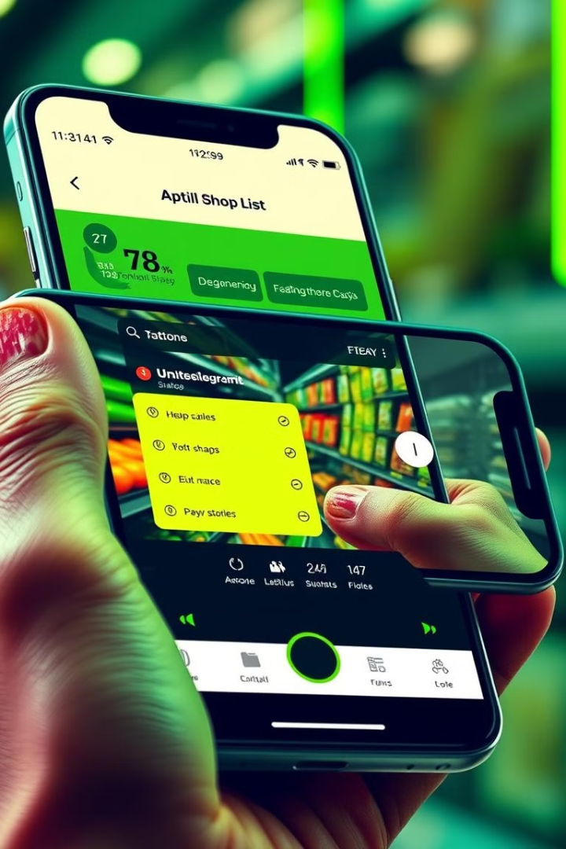



Key Features for Enhanced Shopping
Capture items directly. Add them by taking a photo.
Preserve Log from previous Lists
Tools for controlling your spending.

Slide 9

Conclusion: Simplify Your Shopping Today!
This Shopping List App combines web technologies to deliver a native-like mobile experience. Download now from \[link to app store or website\]. Start simplifying your grocery shopping and stay tuned for upcoming feature enhancements!

Slide 10


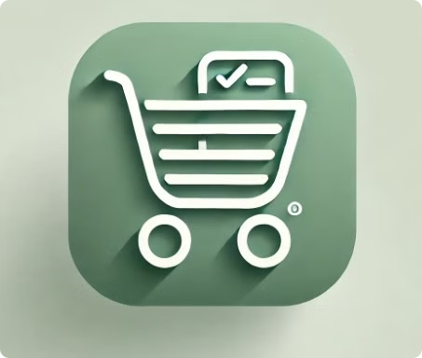



Development Phases
Testing
1
By Esmail
Implementation
2
By Rola
Design
3
By Habiba
Information Gathering and Analysis
4
By Demiana
Project Manager: Ahmed.

